Slide 1
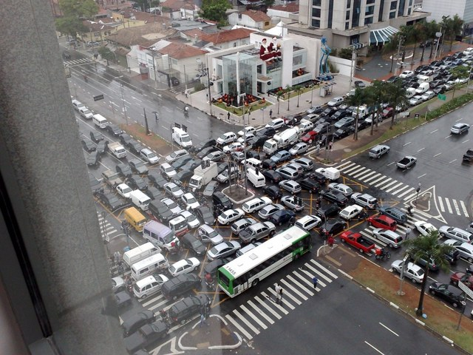
Multiprocessor Synchronization
CSCI 1760
Fall 2024
Lecture 1
Maurice Herlihy
Brown University

Slide 2
Staff

Slide 3
Grading
6 Homeworks (40%)
5 programming assignments (20%)
3 Midterms (40%)

Slide 4
Collaboration
Permitted
talking about homework problems with other students; using other textbooks; using the Internet.
NOT Permitted
Answers obtained directly from anyone or anything else in any form.

Slide 5
Use of AI
Programs
Be prepared to explain & justify design!
Homeworks
Beware of plausible but wrong answers!
Writing
Writing must be your own words

Slide 6
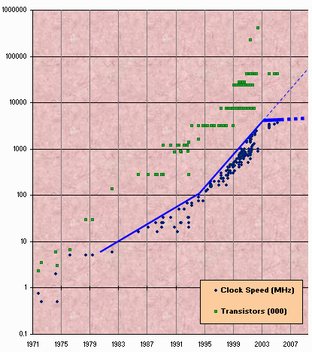
Moore’s Law Literally
Transistor count still rising
Clock speed flattening sharply
6
Notes:
6
Most of you have probably heard of Moore’s law, which states that the number of transistors on a chip tends to double about every two years. Moore’s law has been the engine of growth for our field, and the reason you can buy a laptop for a few thousand dollars that would have cost millions a decade earlier. The green dots on this graph show

Slide 7
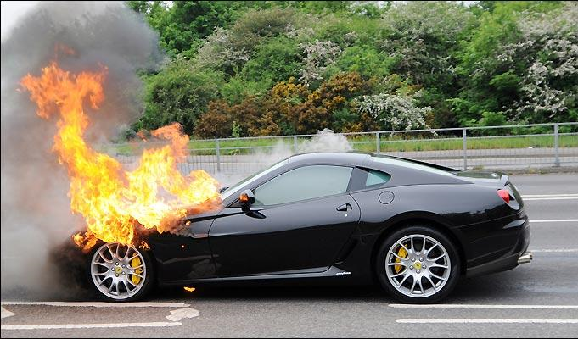
Moore’s Law Actually

Slide 8

Extinct: the Uniprocesor
cpu
memory
8
Notes:
8
Traditionally, we have had inexpensive single processor with an associated memory on a chip, which we call a uniprocessor.

Slide 9
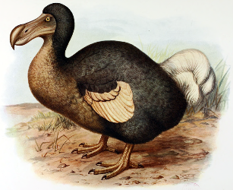
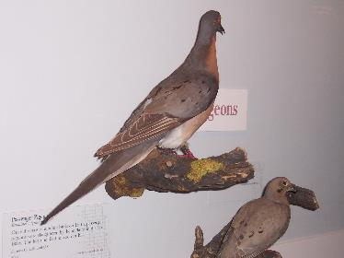
Extinct:
Shared Memory Multiprocessor
(SMP)
cache
cache
cache
Bus
Bus
shared memory
9
Notes:
9
And we had expensive multiprocessor chips in the enterprise, that is, in server farms, high performance computing centers and so on. The
Shared memory multiprocessor (SMP) consists of multiple CPUs connected by a bus or interconnect network to a shared memory.

Slide 10
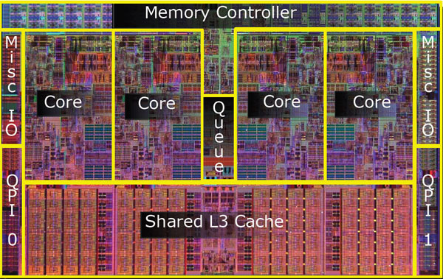
Meet the New Boss:
The Multicore Processor
(CMP)
All on the same chip
10
Notes:
10
The revolution we are going through is that the desktop is now becoming a multiprocessor also. We call this type of processor a system-on-a-chip or a multicore machine or a chip multiprocessor (CMP). The chip you see here is the Sun T2000 Niagara CMP that has 8 cores and shared cache and memory. We will learn about the Niagara in more detail later. It is the machine you will be using for your homework assignments.

Slide 11
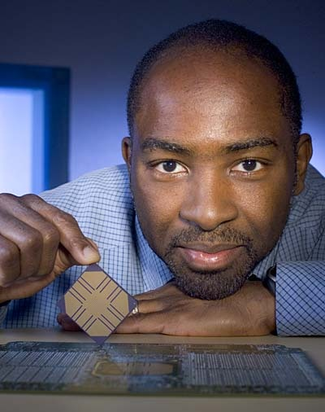
Why is Kunle Smiling?
His new
multicore
11
Notes:
Cause he doesn’t have to write the software…
11

Slide 12
Why do we care?
Time no longer cures software bloat
The “free ride” is over
Double your program’s path length?
You can’t just wait 6 months
You must be twice as parallel!

Slide 13
Traditional Scaling Process
7x
Speedup
3.6x
1.8x
public static void main() {
println("hello world!")
)
}
public static void main() {
println("hello world!")
)
}
public static void main() {
println("hello world!")
)
}
User code
Traditional
Uniprocessor
Time: Moore’s law
13
Notes:
13
Recall the traditional scaling process for software: write it once, trust Intel to make the CPU faster to improve performance.

Slide 14
Ideal Multicore Scaling Process
7x
3.6x
Speedup
1.8x
User code
println("hello world!")
)
println("hello world!")
)
println
println
println
println
Multicore
Unfortunately, not so simple…
14
Notes:
14
With multicores, we will have to parallelize the code to make software faster, and we cannot do this automatically (except in a limited way on the level of individual instructions).

Slide 15
Actual Multicore Scaling Process
3x
2.0x
Speedup
1.8x
User code
println("hello world!")
)
println("hello world!")
)
println
println
println
println
Multicore
Unfortunately, not so simple…
15
Notes:
15
With multicores, we will have to parallelize the code to make software faster, and we cannot do this automatically (except in a limited way on the level of individual instructions).

Slide 16
Multicore Programming:
Course Overview
Fundamentals
Models, algorithms, impossibility
Real-World programming
Architectures
Techniques
16
Notes:
16
Here is our course overview. (at the end, we aim to give you a basic understanding of the issues, not to make you experts)
In this course, we will study a variety of synchronization algorithms,
with an emphasis on informal reasoning about correctness.
Reasoning about multiprocessor programs is different in many ways from the more
familiar style of reasoning about sequential programs.
Sequential correctness is mostly concerned with safety properties,
that is, ensuing that a program transforms each before-state to the correct
after-state.
Naturally, concurrent correctness is also concerned with safety,
but the problem is much, much harder,
because safety must be ensured despite the vast number of ways steps of
concurrent threads can be be interleaved.
Equally important, concurrent correctness encompasses a variety of
\emph{liveness} properties that have no counterparts in the sequential world.
The second part of the book concerns performance.
Analyzing the performance of synchronization algorithms is also different
in flavor from analyzing the performance of sequential programs.
Sequential programming is based on a collection of well-established and
well-understood abstractions.
When you write a sequential program,
you usually do not need to be aware that underneath it all,
pages are being swapped from disk to memory,
and smaller units of memory are being moved in and out of a hierarchy of
processor caches.
This complex memory hierarchy is essentially invisible,
hiding behind a simple programming abstraction.
In the multiprocessor context, this abstraction breaks down,
at least from a performance perspective.
To achieve adequate performance,
the programmer must sometimes ``outwit'' the underlying memory system,
writing programs that would seem bizarre to someone unfamiliar with
multiprocessor architectures.
Someday, perhaps, concurrent architectures will provide the same degree of
efficient abstraction now provided by sequential architectures,
but in the meantime, programmers should beware.
We start then with fundamentals, trying to understand what is and is not computable before we try and write programs. This is similar to the process you have probably gone through with sequential computation of learning computability and complexity theory so that you will not try and solve unsolvable problems. There are many such computational pitfals when programming multiprocessors.

Slide 17
Sequential Computation
thread
memory
object
object
17
Notes:
17

Slide 18
Concurrent Computation
threads
memory
object
object
18
Notes:
18

Slide 19
Asynchrony
Sudden unpredictable delays
  Cache misses (short)
  Page faults (long)
  Scheduling quantum used up (really long)
19
Notes:
19

Slide 20
Model Summary
Multiple threads
Sometimes called processes
Single shared memory
Objects live in memory
Unpredictable asynchronous delays
20
Notes:
20

Slide 21
Road Map
We will focus on principles first, then practice
Start with idealized models
Look at simplistic problems
First correctness, then performance
“Correctness may seem theoretical, but incorrectness has practical impact”
21
Notes:
21
We want to understand what we can and cannot compute before we try and write code. In fact, as we will see there are problems that are Turing computable but not asynchronously computable.

Slide 22
Concurrency Jargon
Hardware: processors, cores
Software: threads or processes
Sometimes OK to conflate them, sometimes not
22
Notes:
22
We will use the terms above, even though there are also terms like strands, CPUs, chips etc also…

Slide 23
Parallel Primality Testing
Challenge
Print primes from 1 to 10¹⁰
10 cores
One thread per core
Goal: ten-fold speedup (or close)
23
Notes:
23
We want to look at the problem of printing the primes from 1 to 10^10 in some arbitrary order.

Slide 24
Load Balancing
1
10⁹
2·10⁹
…
10¹⁰
P₀
P₁
…
P₉
Split work evenly
Each thread tests range of 10⁹
24
Notes:
24
Split the range ahead of time

Slide 25
Procedure for Thread i
void primePrint {
int i = ThreadID.get(); // IDs in {0..9}
for (j = i*109+1, j<(i+1)*109; j++) {
if (isPrime(j))
print(j);
}
}
25
Notes:
25
Code matches code in Chapter 1 of book.

Slide 26
Issues
Higher ranges have fewer primes
Yet larger numbers harder to test
Thread workloads uneven
Hard to predict
26
Notes:
26
You can mention that the use of prime() is a bit artificial since it makes sense to use earlier numbers detected as prime in testing whether a later number is prime.
Jean-Paul Rigault of the University of Nice Sophia Antipolis in France tells us that there are
Overall 454 millions Primes between 1 and 10¹⁰, 51 million of them between 0x10⁹ and 1x10⁹ and 43 million of them between 9x10⁹ and 10x10⁹. The primes seem rather uniformly distributed in the given range, although there are indeed fewer between 9x10⁹ and 10¹⁰ than between 1 and 10⁹ (about 20% less).
He obtained these numbers using a Python program implementing Legendre's approximation for pi(n), the number of primes less than n: pi(n) = n/(log n - 1).

Slide 27
Issues
Higher ranges have fewer primes
Yet larger numbers harder to test
Thread workloads uneven
rejected
Hard to predict
27
Notes:
27
You can mention that the use of prime() is a bit artificial since it makes sense to use earlier numbers detected as prime in testing whether a later number is prime.
Jean-Paul Rigault of the University of Nice Sophia Antipolis in France tells us that there are
Overall 454 millions Primes between 1 and 10¹⁰, 51 million of them between 0x10⁹ and 1x10⁹ and 43 million of them between 9x10⁹ and 10x10⁹. The primes seem rather uniformly distributed in the given range, although there are indeed fewer between 9x10⁹ and 10¹⁰ than between 1 and 10⁹ (about 20% less).
He obtained these numbers using a Python program implementing Legendre's approximation for pi(n), the number of primes less than n: pi(n) = n/(log n - 1).

Slide 28
Shared Counter
19
each thread takes a number
18
17
28
Notes:
28

Slide 29
Thread i
int counter = new Counter(1);
void primePrint {
long j = 0;
while (j < 1010) {
j = counter.getAndIncrement();
if (isPrime(j))
print(j);
}
}
29
Notes:
29

Slide 30
Procedure for Thread i
Counter counter = new Counter(1);
void primePrint {
long j = 0;
while (j < 1010) {
j = counter.getAndIncrement();
if (isPrime(j))
print(j);
}
}
Shared counter
object
30
Notes:
30

Slide 31
Aside:Where Things Live
void primePrint {
int i = ThreadID.get(); // IDs in {0..9}
for (j = i*10⁹+1, j<(i+1)*10⁹; j++) {
if (isPrime(j))
print(j);
}
}
Local
variables
code
cache
cache
cache
Bus
Bus
shared
memory
1
shared counter
31
Notes:
31
Need this slide since some students do not understand where the counter resides, where the shared variables reside, and where the code resides etc. This is our opportunity to explain.

Slide 32
Thread i
Counter counter = new Counter(1);
void primePrint {
long j = 0;
while (j < 10¹⁰) {
j = counter.getAndIncrement();
if (isPrime(j))
print(j);
}
}
Stop when every value taken
32
Notes:
32

Slide 33
Thread i
Counter counter = new Counter(1);
void primePrint {
long j = 0;
while (j < 1010) {
j = counter.getAndIncrement();
if (isPrime(j))
print(j);
}
}
Increment & return each new value
33
Notes:
33

Slide 34
Shared Counter
public class Counter {
private long value;
public long getAndIncrement() {
return value++;
}
}
34
Notes:
34

Slide 35
Shared Counter
public class Counter {
private long value;
public long getAndIncrement() {
return value++;
}
}
OK for single thread,
not for concurrent threads
35
Notes:
35

Slide 36
What It Means
public class Counter {
private long value;
public long getAndIncrement() {
return value++;
}
}
36
Notes:
36

Slide 37
What It Means
public class Counter {
private long value;
public long getAndIncrement() {
return value++;
}
}
temp = value;
value = temp + 1;
return temp;
37
Notes:
37

Slide 38
Uh, oh
Value… 1
2
3
2
read
1
write
2
read
2
write
3
read
1
write
2
time
38
Notes:
38
Time goes from left to right. The Blue thread might read 1 from \fValue{}, but before
it sets \fValue{} to 2, the Red thread would go through the
increment loop several times, reading 1 and setting to 2, reading
2 and setting to 3. When the Blue thread finally completes its
operation and sets \fValue{} to 2, it will actually be setting
the counter back from 3 to 2.

Slide 39
Is this problem inherent?
!!
!!
write
read
read
write
If we could only glue reads and writes together…
39
Notes:
39
Is this phenomena inherent or is there a better implementation we are missing?
To understand why such bad interleavings can always happen, consider
the following situation that all of us run into every once in a while.
You are walking down the street, and
suddenly someone is coming straight at you. You move to the right, and they
move to the right, so you move to the left, and they happen to do the
same, now you try and make a final break to either left or right, many
times you manage not to bump, but sometimes you do. Are these
collisions avoidable? Can we think of a protocol to follow in order to
prevent people from ever colliding?
The answer is NO! \footnote{One might think that you
can agree to always move to the right, to which you can answer ``but
what if the other person is British?'' Alternately,
think of Atlantis and Mir flying one towards the other in space, where
the is no predefined ``right side.''} It can be mathematically shown
that there is always a sequence of moves that will result in people
bumping (this is the famous result of Fischer, Lynch, and Paterson we will
Study later in the course).
The problem arises from the fact that ``looking'' at the other person
and ``moving'' aside to avoid him are two separate operations. If one
could ``look-and-jump'' instantaneously the problem could be avoided.
In the same way that people compete for the right to pass, computers
compete to gain access to shared locations in memory. In the case of
our {\tt shared-counter}, processors are in a competition where the
winner gets the lower counter value and the looser gets the higher
one. The moral of the ``people in the street'' example is that we need
to ``glue together'' the {\tt get} and {\tt increment} operations to
get an ``instantaneous'' {\tt get-and-increment}. This operation
would execute the {\tt get} and the {\tt increment} instructions
like one indivisible operation with no other operation taking place
between the start of the {\tt get} and the end of the {\tt
increment}. If we have such an operation then the following is a
correct and efficient solution to the prime printing problem.

Slide 40
Challenge
public class Counter {
private long value;
public long getAndIncrement() {
temp = value;
value = temp + 1;
return temp;
}
}
Make these steps atomic (indivisible)
40
Notes:
40

Slide 41
Hardware Solution
public class Counter {
private long value;
public long getAndIncrement() {
temp = value;
value = temp + 1;
return temp;
}
}
HW ReadModifyWrite()
Instruction?
41
Notes:
41
We will see later that modern multiprcessors provide special types of readModiftWrite() instructions to allow us to overcome the
problem at hand. But how do we solve this problem in software?

Slide 42
An Aside: Java™
public class Counter {
private long value;
public long getAndIncrement() {
synchronized {
temp = value;
value = temp + 1;
}
return temp;
}
}
Synchronized block
42
Notes:
42

Slide 43
An Aside: Java™
public class Counter {
private long value;
public long getAndIncrement() {
synchronized {
temp = value;
value = temp + 1;
}
return temp;
}
}
Mutual Exclusion
43
Notes:
43
Java provides us with a solution: mutual exclusion in software…lets try and understand how this is done

Slide 44
Mutual Exclusion, or “Alice & Bob share a pond”
B
A
44
Notes:
44
We now present a sequence of fables, illustrating some of the basic problems.
Like most authors of fables, we retell stories mostly invented by others. The following story was told by a famous
Multiprocessing pioneer, Leslie Lamport.
See story outline in the Introduction Chapter of the Book.

Slide 45
Alice has a pet
B
A
45
Notes:
45

Slide 46
Bob has a pet
A
B
A
46
Notes:
46

Slide 47
The Problem
B
A
The pets don’t
get along
47
Notes:
47

Slide 48
Two kinds of Properties
Safety
Nothing bad ever happens
Liveness
Something good eventually happens
48
Notes:
48

Slide 49
A Safety Property
Mutual Exclusion
Both pets never in pond simultaneously
49
Notes:
49
Notice that we use the term deadlock and not livelock though some people would use both to describe the
Requirement. They are not the same thing. Deadlock is used to denote that Alice and Bob are stuck and no amount of retry (backoff) will help, while livelock means backoff can help. In any case both are different from “no starvation” which is the stronger requirement that means that every request always succeeds.

Slide 50
A Liveness Property
No Deadlock
if only one wants in, it gets in
if both want in, one gets in
Notes:
Notice that we use the term deadlock and not livelock though some people would use both to describe the
Requirement. They are not the same thing. Deadlock is used to denote that Alice and Bob are stuck and no amount of retry (backoff) will help, while livelock means backoff can help. In any case both are different from “no starvation” which is the stronger requirement that means that every request always succeeds.

Slide 51
Simple Protocol
Idea
Just look at the pond
Gotcha!
Not atomic
(Trees obscure the view)
51
Notes:
51
In the following versions of the protocol, we try and show the students which solutions will not work.
Can ask students for help in the solution by showing the first part of the slide (the Idea part) and then show the
Gotcha part once they have suggested solutions. This is true for all the next set of suggested solutions.

Slide 52
Interpretation
Threads can’t “see” what other threads are doing
Explicit communication required for coordination
52
Notes:
52

Slide 53
Cell Phone Protocol
Idea
Bob calls Alice (or vice-versa)
Gotcha!
Bob takes shower
Alice recharges battery
Bob out shopping for pet food …
53
Notes:
53

Slide 54
Interpretation
Message-passing doesn’t work
Recipient might not be
Listening
There at all
Communication must be
Persistent (like writing)
Not transient (like speaking)
54
Notes:
54

Slide 55
Can Protocol
cola
cola
55
Notes:
55

Slide 56
Bob conveys a bit
B
A
cola
56
Notes:
56

Slide 57
Bob conveys a bit
B
A
cola
57
Notes:
57

Slide 58
Can Protocol
Idea
Cans on Alice’s windowsill
Strings lead to Bob’s house
Bob pulls strings, knocks over cans
Gotcha
Cans cannot be reused
Bob runs out of cans
58
Notes:
58

Slide 59
Interpretation
Cannot solve mutual exclusion with interrupts
Sender sets fixed bit in receiver’s space
Receiver resets bit when ready
Requires unbounded number of interrupt bits
59
Notes:
59
Notice that the point here is that it can be used as a solution but takes an unbounded number of inturrupt bits. This is not the case with the next solution…

Slide 60
Flag Protocol
B
A
60
Notes:
60
Here is a solution that does not suffer from the problems of the former ones…

Slide 61
Alice’s Protocol (sort of)
B
A
61
Notes:
61

Slide 62
Bob’s Protocol (sort of)
B
A
62
Notes:
62

Slide 63
Alice’s Protocol
Raise flag
Wait until Bob’s flag is down
Unleash pet
Lower flag when pet returns
63
Notes:
63

Slide 64
Bob’s Protocol
Raise flag
Wait until Alice’s flag is down
Unleash pet
danger!
Lower flag when pet returns
64
Notes:
64
Does not meet our requirement of no deadlock. Need to improve the protocol. Can ask students for help.

Slide 65
Bob’s Protocol (2nd try)
Raise flag
While Alice’s flag is up
Lower flag
Wait for Alice’s flag to go down
Raise flag
Unleash pet
Lower flag when pet returns
65
Notes:
65

Slide 66
Bob’s Protocol
Raise flag
Bob defers to Alice
While Alice’s flag is up
Lower flag
Wait for Alice’s flag to go down
Raise flag
Unleash pet
Lower flag when pet returns
Art of Multiprocessor Programming
66
Notes:
66

Slide 67
The Flag Principle
Raise flag
Look at other’s flag
Flag Principle:
If each raises and looks, then
Last to look must see both flags up
67
Notes:
67
This intuitively explains implies why at least one of them will not
enter the critical section if both are trying at the same time. Many coordination protocols use falg raising and
The flag principle to guarantee that threads notice each other.
The following proof of mutual exclusion will not be
presented in class, but we provide it just to give you some intuition
about how one reasons about concurrent programs. Lets prove that if
they follow the algorithm the dogs will never be together in the yard.
Assume by way contradiction that this is not the case. We are assuming
that both dogs are in the yard. Therefore both Alice and Bob had a
last ``looking'' action before they let their dog enter the yard. Lets
take a look at the one who finished this looking action first. When he
(she) looked, he (she) saw that the other one's flag was down. Without
loss of generality let's assume it was Bob, so he had {\tt (=
Alice-flag 'down)} as true, otherwise he couldn't have entered the
critical section. So it follows that Alice's flag was up {\em after}
Bob finished his looking action. Therefore, Alice's looking was {\em
completely after} the end of Bob's raising of his flag, so Alice must
have seen this flag up and could not have entered the critical
section, a contradiction.

Slide 68
Proof of Mutual Exclusion
Assume both pets in pond
Derive a contradiction …
By reasoning backwards
68
Notes:
68
If both look at the same time, then its OK to assume that Alice looked last. They both have different protocols but the part of the protocols that raises the flag for the last time and looks if the other’s flag is raised is the same.

Slide 69
Proof of Mutual Exclusion
Consider the last time Alice and Bob each looked before letting the pets in
Without loss of generality assume Alice was the last to look…
69
Notes:
69
If both look at the same time, then its OK to assume that Alice looked last. They both have different protocols but the part of the protocols that raises the flag for the last time and looks if the other’s flag is raised is the same.

Slide 70
Proof
Bob last raised flag
Alice last raised her flag
Alice’s last look
Bob’s last look
QED
time
Alice must have seen Bob’s Flag. A Contradiction
70
Notes:
70
Explanation: assume without loss of generality that Alice was the last to look in the last look each performed before they both let their animals in the pond concurrently. Then Bob’s last look must have been
before Alice’s last flag raising since Bob let his pet into the pond. But since Bob raised his flag before he looked, it follows that Alice must have seen Bob’s flag raised, a contradiction.

Slide 71
Proof of No Deadlock
If only one pet wants in, it gets in.
Deadlock means both continually trying to get in.
If Bob sees Alice’s flag, he backs off, gives her priority (Alice’s lexicographic privilege)
QED
71
Notes:
71

Slide 72
Remarks
Protocol is unfair
Bob’s pet might never get in
Protocol uses waiting
If Bob is eaten by his pet,
Alice’s pet might never get in
72
Notes:
72
The protocol is unfair. Another property of compelling interest above no-deadlock is no-starvation:
if a pet wants to enter the yard, will it eventually succeed?
Here, Alice and Bob's protocol performs poorly. Whenever Alice and
Bob conflict, Bob defers to Alice, so it is possible that Alice's
pet can use the pond over and over again, while Bob's pet becomes
increasing uncomfortable. Later on, we will see how to make
protocols prevent starvation.
Waiting is problematic in terms of performance as we will explain in more detail later in the lecture

Slide 73
Moral of Story
Mutual Exclusion cannot be solved by
transient communication (cell phones)
interrupts (cans)
It can be solved by
one-bit shared variables
that can be read or written
73
Notes:
73
During the course we will devote quite a bit of effort to understanding the tradeoffs that have to do with the use of mutual exclusion.

Slide 74
The Arbiter Problem (an aside)
Pick a point
Pick a point
74
Notes:
74
Notice that when Alice or Bob look at the otehrs flag, it might be in the process of being raised, which
Means we need to decide from what point on the flag is up or down. We essentially want to turn a continuous process of raising the flag into a discrete process in which it only has two states and we never have an intermediate “undefined” state. The same issue arises in memory. Bits of memory are in many cases electrical units called flip-flops. If a current representing a bit of either 0 or 1 is entered into a flip-flops input wires, we would like to think of the output as either 0 or 1. But this process takes time, and the current coming out of the
flip-flop is not discrete, if we measure it at different times, especially if we measure it before the output current has stabilized, we will not get a guaranteed correct behaviour. In other words, as with the flags, we might be catching it while the bit is being raised or lowered. What hardware manufacturers do is decide on a time when they believe the current on the output will be stable. However, as the lower figure shows, picking such a point is a probabilistic event, that is, if we test the gate after 5 nano-seconds, there is always a probability that it will not give us the correct corresponding output given the inputs because the gate is unstable. However, this time is chosen so that the probability is small enough that other failure probabilities (like the probability that a spec of dust will neutralize a flip-flop) are higher.

Slide 75
The Fable Continues
Alice and Bob fall in love & marry
Then they fall out of love & divorce
She gets the pets
He has to feed them
Leading to a new coordination problem:
Producer-Consumer
75
Notes:
75
Joke: say that with a probability of 50% they divorce.

Slide 76
Bob Puts Food in the Pond
A
B
76
Notes:
76

Slide 77
Alice releases her pets to Feed
mmm…
B
A
mmm…
77
Notes:
77

Slide 78
Producer/Consumer
Alice and Bob can’t meet
Each has restraining order on other
So he puts food in the pond
And later, she releases the pets
Must avoid
Releasing pets when there’s no food
Putting out food if uneaten food remains
78
Notes:
78
Many coordination problems are producer consumer problems, in fact, whenever an algorith involves the word “buffer” chances are high that we are talking about a producer consumer algorithm.

Slide 79
Producer/Consumer
Need a mechanism that ensures
Bob lets Alice know when food has been put out
Alice lets Bob know when to put out more food
79
Notes:
79

Slide 80
Surprise Solution
B
B
A
cola
80
Notes:
80

Slide 81
Bob puts food in Pond
B
A
cola
81
Notes:
81

Slide 82
Bob knocks over Can
B
A
cola
82
Notes:
82

Slide 83
Alice Releases Pets
yum…
A
B
B
B
A
yum…
cola
83
Notes:
83

Slide 84
Alice Resets Can when Pets are Fed
B
A
cola
84
Notes:
84

Slide 85
Pseudocode
while (true) {
while (can.isUp()){};
pet.release();
pet.recapture();
can.reset();
}
Alice’s code
85
Notes:
85

Slide 86
Pseudocode
while (true) {
while (can.isUp()){};
pet.release();
pet.recapture();
can.reset();
}
Bob’s code
while (true) {
while (can.isDown()){};
pond.stockWithFood();
can.knockOver();
}
Alice’s code
86
Notes:
86

Slide 87
Correctness
safety
Mutual Exclusion
Pets and Bob never together in pond
liveness
No Starvation
if Bob always willing to feed, and pets always famished, then pets eat infinitely often.
Producer/Consumer
safety
The pets never enter pond unless there is food, and Bob never provides food if there is unconsumed food.
87
Notes:
87
Producer/Consumer:
The pets will not enter the yard unless there is food, and Bob
will never provide more food if there is unconsumed food.
Let the students guess which property is a safety property and which is a liveness property.

Slide 88
Could Also Solve Using Flags
B
A
88
Notes:
88

Slide 89
Waiting
Both solutions use waiting
while (condition) {doNothing()}
Sometimes waiting is problematic
If one party is delayed …
So is everyone else
But delays are common & unpredictable
89
Notes:
89
Again, waiting si problematic as one delays all causing the computation to proceed in a sequential manner.

Slide 90
The Fable drags on …
Bob and Alice still have issues
So they need to communicate
They agree to use billboards …
90
Notes:
90

Slide 91
Billboards are Large
B
D
Letter
Tiles
From Scrabble™ box
A
A
C
2
3
E
1
3
1
91
Notes:
91
One tile at a time.

Slide 92
Write One Letter at a Time …
W
A
S
4
1
1
H
4
A
B
D
A
C
2
3
E
1
3
1
92
Notes:
92

Slide 93
To post a message
W
A
S
H
T
H
E
C
A
R
4
1
1
4
1
4
1
3
1
1
whew
A
93
Notes:
93

Slide 94
Let’s send another message
L
A
S
E
L
L
L
A
V
A
1
1
S
1
1
1
1
1
1
4
1
M
P
3
3
1
A
94
Notes:
94

Slide 95
Uh-Oh
S
E
L
L
T
H
E
C
A
R
1
1
1
1
1
4
1
3
1
1
L
1
A
OK
B
95
Notes:
95

Slide 96
Readers/Writers
Devise a protocol so that
Writer writes one letter at a time
Reader reads one letter at a time
Reader sees “snapshot”
Old message or new message
No mixed messages
96
Notes:
96
This is a classical problem that captures how our machines memory really behaves. Memory consists of individual words that can be read or written one at a time, want if we read what is being written one word at a time while others are writing memory one word at a time, how can we guarantee to see correct values.

Slide 97
Readers/Writers (continued)
Easy with mutual exclusion
But mutual exclusion requires waiting
One waits for the other
Everyone executes sequentially
Remarkably
We can solve R/W without mutual exclusion
97
Notes:
97
Its also easy with producer-consumer interrupt bit based solution if we have one producer and one consumer.
Using Mutex for large chunks of memory introduces performance problems. The surprising thing is that we can actually provide a “snapshot” of memory by reading memory locations one at a time, and while others are continuously writing it, all this WITHOUT mutual exclusion. Stay tuned to see how we do this.

Slide 98
Amdahl’s Law
1-thread execution time
Speedup =
n-thread execution time
98
Notes:
98
This kind of analysis is very important for concurrent computation.
The formula we need is called \emph{Amdahl's Law}.
It captures the notion that the extent to
which we can speed up any complex job (not just painting)
is limited by how much of the job must be executed sequentially.
Define the \emph{speedup} $S$ of a job to be the ratio between the
time it takes one processor to complete the job (as measured by a wall clock)
versus the time it takes $n$ concurrent processors to complete the same job.
\emph{Amdahl's Law} characterizes the maximum speedup $S$ that can be achieved by $n$
processors collaborating on an application where $p$ is the fraction of
the job that can be executed in parallel.
Assume, for simplicity,
that it takes (normalized) time 1 for a single processor to complete the job.
With $n$ concurrent processors, the parallel part takes time $p/n$ and the sequential part takes time $1-p$.
Overall, the parallelized computation takes time:
$$
1 - p + \frac{p}{n}
$$
Amdahl's Law says that the speedup, that is,
the ratio between the sequential (single-processor) time and the parallel time,
is:
$$
S = \frac{1}{1 - p + \frac{p}{n}}
$$
We show this in the next set of slides

Slide 99
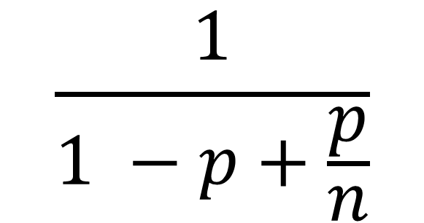
Amdahl’s Law
$$\frac{1}{1 −p+\frac{p}{n}}$$
Speedup =
99
Notes:
99
AVOID USING THE WORD “CODE”, P is not a fraction of the code but if the execution time of the solution algorithm. It could be that 5% of the code are executed in a loop and account for 90% of the execution time.

Slide 100
Amdahl’s Law
Parallel fraction
$$\frac{1}{1 −p+\frac{p}{n}}$$
Speedup =
100
Notes:
100

Slide 101
Amdahl’s Law
Sequential fraction
Parallel fraction
$$\frac{1}{1 −p+\frac{p}{n}}$$
Speedup =
101
Notes:
101

Slide 102
Amdahl’s Law
Sequential fraction
Parallel fraction
$$\frac{1}{1 −p+\frac{p}{n}}$$
Speedup =
Number of threads
102
Notes:
102

Slide 103
Amdahl’s Law
Bad synchronization ruins everything

Slide 104
Example
Ten cores
60% concurrent, 40% sequential
How close to 10-fold speedup?
Speedup = 2.17
104
Notes:
104

Slide 105
Example
Ten cores
80% concurrent, 20% sequential
How close to 10-fold speedup?
Speedup = 3.57
105
Notes:
105

Slide 106
Example
Ten cores
90% concurrent, 10% sequential
How close to 10-fold speedup?
Speedup = 5.26
106
Notes:
106

Slide 107
Example
Ten cores
99% concurrent, 1% sequential
How close to 10-fold speedup?
Speedup = 9.17
107
Notes:
107

Slide 108
Actual Scaling Process
2x
2.9x
Speedup
1.8x
User code
println("hello world!")
)
println("hello world!")
)
println
println
println
println
Multicore
Not reducing sequential % of code
108
Notes:
108
With multicores, we will have to parallelize the code to make software faster, and we cannot do this automatically (except in a limited way on the level of individual instructions).

Slide 109
Shared Data Structures
Honk!
Honk!
Honk!
Why only 2.9 speedup
Coarse
Grained
Fine
Grained
25%
Shared
25%
Shared
75%
Unshared
75%
Unshared

Slide 110
Shared Data Structures
Honk!
Honk!
Why fine-grained parallelism maters
Honk!
Coarse
Grained
Fine
Grained
25%
Shared
25%
Shared
75%
Unshared
75%
Unshared

Slide 111
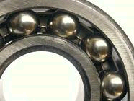
Diminishing Returns
This course is about the parts that
are hard to make concurrent …
but still have a big influence on speedup!
Notes:
With 25% sequential, cannot do more than

Slide 112
one
two
three
four
five

